Slide 1
Barbara Surdykowska, Instytut Spraw Publicznych

Slide 2
Making the EU climate neutral by 2050
In 2021 the EU adopted its first EU Climate Law. It set in stone Europe's goals to become climate-neutral by 2050, as well as a target of 55% less emissions by 2030, in comparison to 1990.
As required under the Climate Law, the Commission also recommended, in February 2024, an additional intermediate target of 90% less emissions by 2040, confirming our direction of travel.

Slide 3
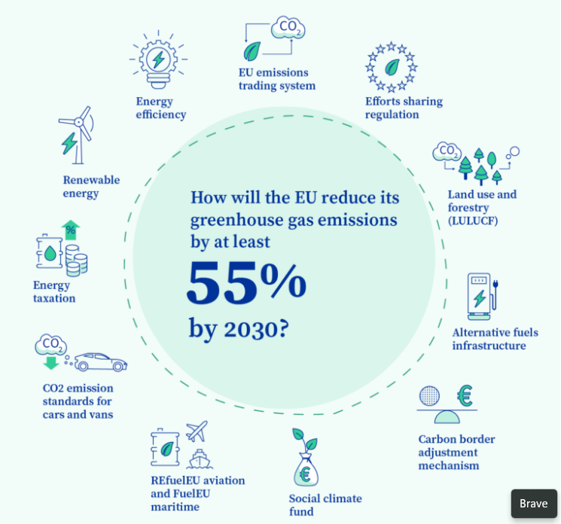

Slide 5
Green Deal Industrial Plan
Critical Raw Materials Act
Net-zero Industry Act
Zero Pollution Action Plan
Farm to Fork Strategy
Regulation on Deforestation-free Products
Nature Restoration Law

Slide 6
Directive on repair of goods
Energy Performance of Buildings Directive
Directive on empowering consumers for the green transition ECD Directive
Green Claims Directive (GCD) – proposal

Slide 7
30 July 2024 -Entry into force of the new Directive on repair of goods
The Directive on common rules promoting the repair of goods was adopted on 13 June 2024 and entered into force on 30 July 2024. Member States have to transpose it into national rules and apply it from 31 July 2026.
Obligation to repair
Manufacturers of products (e.g., fridges or smartphones) that are subject to reparability requirements in EU law and listed in Annex II of the Directive will have to repair those products within a reasonable time and for a reasonable price. Such repairability requirements are set in the product-specific legislation, mainly implementing the Ecodesign Directive and the Regulation on Ecodesign for Sustainable Products mentioned before. Annex II to the Directive provides a list of products to which this obligation applies. In addition, manufacturers will be prohibited from using contractual clauses, hardware or software techniques that impede the repair of goods listed in Annex II unless justified by legitimate and objective factors. They will be also obliged to provide access to spare parts at reasonable prices.

Slide 8
30 July 2024 -Entry into force of the new Directive on repair of goods
Manufacturers are required to make available information on their repair services to consumers in an easily accessible manner. This could be done, for example, on their website or in the instruction manuals. In addition, they must inform consumers on a free access website about the indicative prices charged for typical repairs.
Extension of the legal guarantee after repair
The Directive also amended the existing Sale of goods Directive (EU) 2019/771. The amendment provides consumers with an extra year of the legal guarantee if they choose to repair the product instead of replacing it under the legal guarantee.

Slide 9
12 April 2024 Adoption of the strengthened Energy Performance of Buildings Directive
This legislation sets the framework for Member States to reduce emissions and energy use in buildings across the EU, from homes and workplaces to schools, hospitals and other public buildings.
This will help improve people's health and quality of life. The revised Directive sets ambitious targets to reduce the overall energy use of buildings across the EU, taking into account national specificities.
It leaves in Member States' hands which buildings to target and which measures to take.

Slide 10
12 April 2024 Adoption of the strengthened Energy Performance of Buildings Directive
Buildings are responsible for around 40% of the EU's energy consumption, more than half of EU gas consumption (mainly through heating, cooling and domestic hot water), and 35% of the energy-related greenhouse gas emissions.
At present, about 35% of the EU's buildings are over 50 years old and almost 75% of the building stock is energy inefficient.
At the same time, the average annual energy renovation rate is only about 1%.

Slide 11
12 April 2024 Adoption of the strengthened Energy Performance of Buildings Directive
Each Member State will adopt its own national trajectory to reduce the average primary energy use of residential buildings, by 16% by 2030 and 20-22% by 2035.
For non-residential buildings, they will need to renovate the 16% worst-performing buildings by 2030 and the 26% worst-performing buildings by 2033.
Member States will have the possibility to exempt certain categories of residential and non-residential buildings from these obligations, including historical buildings or holiday homes.
Citizens will be supported in their efforts to improve their homes.

Slide 12
12 April 2024 Adoption of the strengthened Energy Performance of Buildings Directive
All new residential and non-residential buildings must have zero on-site emissions from fossil fuels, as of 1 January 2028 for publicly-owned buildings and as of 1 January 2030 for all other new buildings, with a possibility for specific exemptions.
The strengthened Directive contains new provisions to progressively phase-out fossil fuels from heating in buildings and boost the deployment of solar power installations, taking into account the national circumstances.

Slide 13
Green Deal Industrial Plan
The Green Deal Industrial Plan creates conditions for the scaling up of manufacturing capacity for the net-zero technologies and products required to meet Europe’s climate targets.

Slide 14
Critical Raw Materials Act
The Critical Raw Materials Act will help ensure the EU’s access to a secure, diversified, affordable and sustainable supply and to increase domestic capacities for critical raw materials

Slide 15
Net-zero Industry Act
The Net-Zero Industry Act will boost the manufacturing of net-zero technologies in the EU and strengthen their resilience and competitiveness.

Slide 16
Zero Pollution Action Plan
The Commission’s Zero Pollution Action Plan resulted in proposals for modernised standards on water quality, air quality, industrial emissions, chemicals, and transparency and clearer financing, so pollution costs fall less on the taxpayer.

Slide 17
Farm to Fork Strategy
Farm to Fork Strategy intends to make food supply systems fair and healthy, safeguard EU food security and affordability, while rewarding farmers for providing environmental and climate-friendly services.

Slide 19
Farm to Fork Strategy

Slide 20
Farm to Fork Strategy

Slide 22
Regulation on Deforestation-free Products
By promoting the consumption of ‘deforestation-free’ products and reducing the EU’s impact on global deforestation and forest degradation, the new Regulation (EU) 2023/1115 on deforestation-free products is expected to bring down greenhouse gas emissions and biodiversity loss.
The Regulation is part of a broader plan of action to tackle deforestation and forest degradation first outlined in the 2019 Commission Communication on Stepping up EU Action to Protect and Restore the World’s Forests.

Slide 23
Regulation on Deforestation-free Products
On 29 June 2023, the Regulation on deforestation-free products entered into force.
The main driver of deforestation is the expansion of agricultural land that is linked to the production of commodities like cattle, wood, cocoa, soy, palm oil, coffee, rubber, and some of their derived products, such as leather, chocolate, tyres, or furniture. As a major economy and consumer of these commodities linked to deforestation and forest degradation, the EU is partly responsible for this problem and it wants to lead the way to solving it.
Under the Regulation, any operator or trader who places these commodities on the EU market, or exports from it, must be able to prove that the products do not originate from recently deforested land or have contributed to forest degradation.

Slide 24
Regulation on Deforestation-free Products
30 December 2024
Rules begin to apply for medium & large operators and traders
30 June 2025
Rules begin to apply for micro and small enterprises
Which products are covered?
Palm oil, cattle, soy, coffee, cocoa, timber, rubber, and products derived from the listed commodities (such as beef, furniture, or chocolate)

Slide 25
18 August 2024- Nature Restoration Law enters into force
Full implementation of the law is crucial to restore the EU’s biodiversity and stop further biodiversity loss, to reach climate neutrality by 2050 and adapt to climate change, and to enhance food security for EU citizens. In doing so, the law will support the achievement of other European ambitions, such as water security.
It is also a key instrument to help the EU and its Member States meet international biodiversity commitments under the Kunming-Montreal Global Biodiversity Framework.
As an overall target to be reached at the EU level, Member States will put in place restoration measures in at least 20% of the EU's land areas and 20% of its sea areas by 2030. By 2050, such measures should be in place for all ecosystems that need restoration.
By 2030, the objective of restoring at least 25,000 km of rivers into free-flowing rivers. In addition, it will contribute to reversing the decline of pollinator populations and improving their diversity, enhance biodiversity in agricultural ecosystems and the biodiversity of forest ecosystems, and contribute to the commitment to plant at least three billion additional trees by 2030 at the EU level.

Slide 26
18 August 2024- Nature Restoration Law enters into force
Different restoration targets apply to different ecosystems and Member States will decide the specific measures they will put in place on their territories. For this purpose, each Member State will develop a national restoration plan, setting out restoration needs and measures to fulfil the obligations and achieve the targets of the law adapted to the national context, and taking into account the diversity of different regions.
National restoration plans should include a timeline for implementation, the financial resources needed and intended means of financing, as well as expected benefits, especially for climate change adaptation and mitigation. Member States need to identify synergies with other policies, such as climate change mitigation and adaptation, land degradation, disaster prevention, agriculture, fisheries, forestry and renewable energy development.
Member States must submit a draft plan to the Commission within two years from the date of entry into force, setting out milestones for 2030, 2040 and 2050. These plans need to be developed openly and transparently, allowing the public and all relevant stakeholders to participate in the process. The Commission will support national authorities in creating these plans.

Slide 27
30 July 2024 -Entry into force of the new Directive on repair of goods
National measures promoting repair
Member States will have to take at least one measure promoting repair on their territory. This can include both financial and non-financial measures such as information campaigns, repair vouchers, trainings in repair skills.
This list currently includes: washing machines, washer-dryers, fridges, dishwashers, TVs, vacuum cleaners, tumble dryers, welding equipment, smartphones, tablets, cordless phones, servers and data storage products, and goods incorporating light means of transport batteries.
The obligation to repair applies only to consumer goods, i.e., goods acquired by natural persons for non-professional use.

Slide 28
27 March 2024 Entry into force of the Directive on empowering consumers for the green transition ECD Directive
Before buying a product, consumers will receive better and more harmonised information on its durability and reparability. Consumers will also be better informed about their legal guarantee rights. In addition, vague environmental claims will be forbidden, meaning that companies will no longer be able to declare that they are ‘green’ or ‘environmentally friendly’ if they cannot demonstrate that they are. It will also be forbidden to display unreliable voluntary sustainability logos. In addition, unfair commercial practices linked to early obsolescence will be prohibited, such as false claims about the sustainability of an asset.

Slide 29
27 March 2024 Entry into force of the Directive on empowering consumers for the green transition ECD Directive
Vera Jourová, Vice-President for Values and Transparency, said
'Empowering consumers for the green transition means giving European citizens the tools to make informed choices and preventing practices such as greenwashing and early obsolescence from being used in the single market.'
EU countries are required to transpose the Directive into their national law by 27 March 2026. The rules will apply from 27 September 2026.
Directive (EU) 2024/825 of the European Parliament and of the Council of 28 February 2024 amending Directives 2005/29/EC and 2011/83/EU as regards empowering consumers for the green transition through better protection against unfair practices and through better information (Text with EEA relevance)

Slide 30
27 March 2024 Entry into force of the Directive on empowering consumers for the green transition ECD Directive
More specifically, the ECD amends the provisions of the Unfair Commercial Practices Directive (UCPD) and the Consumer Rights Directive (CRD) to introduce obligations to provide clear and relevant information concerning environmental or social claims and circularity aspects of the products.
The ECD will operate alongside the Green Claims Directive (GCD), which will create a specialized regime to govern environmental claims, and is currently in the early stages of the legislative process

Slide 31
27 March 2024 Entry into force of the Directive on empowering consumers for the green transition ECD Directive
Broad definition of “environmental claim.” Any non-mandatory message or representation in any form (e.g., text, pictorial, symbolic) stating or implying that a product/brand/trader has (i) a “positive or zero impact” on the environment, (ii) is “less damaging” than its competitors, or (iii) has “improved its impact” over time.
Expanded list of prohibited commercial practices. The ECD identifies the following practices as necessarily unfair, without a case-by-case assessment
Harmonization of information on durability.

Slide 32
Green Claims Directive (GCD) – proposal
A Commission study, mentioned in the proposal, finds that more than half of all environmental claims in the EU were based on vague, misleading, or unfounded information.
Environmental claims must be verified: An authorized third party must verify the substantiation and communication of a claim before it is used publicly. When verified, a claim will receive an EU certificate of conformity.

Slide 34
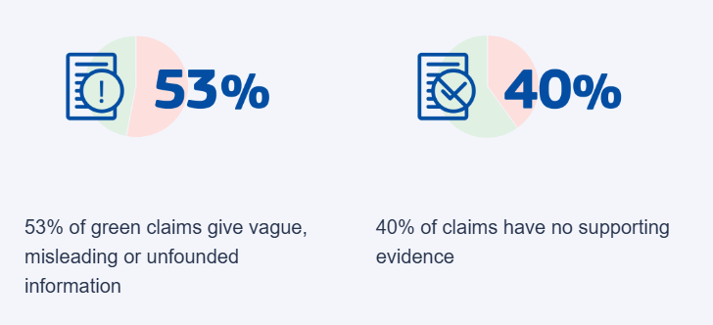

Slide 35
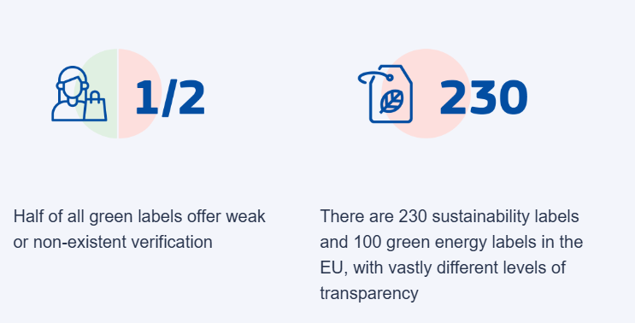

Slide 36
Green Claims Directive (GCD) – proposal
The proposal on green claims aims to:
make green claims reliable, comparable and verifiable across the EU
protect consumers from greenwashing
contribute to creating a circular and green EU economy by enabling consumers to make informed purchasing decisions
help establish a level playing field when it comes to environmental performance of products

