Slide 1
Barbara Surdykowska, ISP

Slide 3
Public opinion
https://europa.eu/eurobarometer/surveys/detail/3173

Slide 9
https://www.europarl.europa.eu/RegData/etudes/BRIE/2024/762448/EPRS_BRI(2024)762448_EN.pdf

Slide 11
Citizen support for climate action
https://climate.ec.europa.eu/citizens/citizen-support-climate-action_en

Slide 14
There is strong support for action to tackle climate change and make Europe climate neutral
88% of respondents – and at least 70% in each Member State – agree that greenhouse gas emissions should be reduced to a minimum while offsetting the remaining emissions for a climate-neutral EU economy by 2050.
87% of respondents think it is important that their national government take action to increase the amount of renewable energy used and 86% believe governments should take action to improve energy efficiency by 2030.
67% think their national governments are not doing enough to tackle climate change.
More than eight in ten (87%) think the EU should take action to increase renewable energy and support energy efficiency (85%).
Most Europeans support accelerating decarbonisation in response to Russia’s invasion of Ukraine
The majority (58%) believe that the European Union should accelerate the transition to a green economy in view of the energy crisis triggered by Russia’s invasion of Ukraine.

Slide 15
Malta

Slide 16
Poland

Slide 17
Portugal

Slide 18
Slovakia

Slide 19
https://www.intelligentcitieschallenge.eu/sites/default/files/2023-03/2023-Local%20Green%20Deals-update-final.pdf

Slide 20
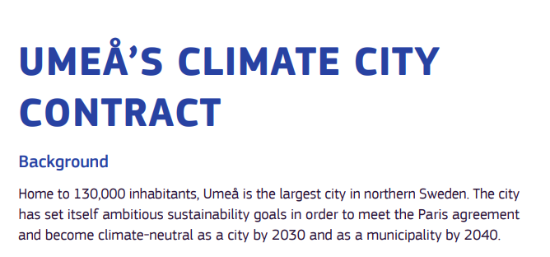
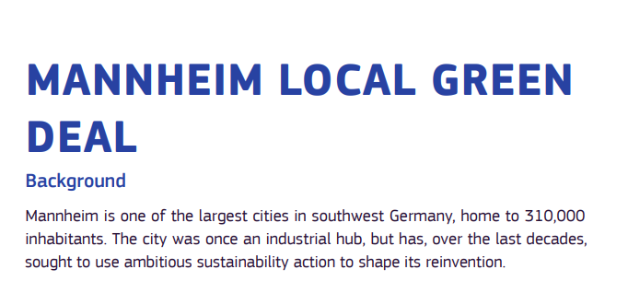

Slide 21
Coal regions in transition Initiative
To ensure that no region, worker or community is left behind in the energy transition, the Commission launched the Coal regions in transition Initiative (CRiT) in 2017 to help mitigate the social consequences of the low-carbon transition in coal, peat and oil shale regions of the European Union.
https://energy.ec.europa.eu/topics/carbon-management-and-fossil-fuels/eu-coal-regions-transition_en

Slide 22
The national energy and climate plans
https://commission.europa.eu/energy-climate-change-environment/implementation-eu-countries/energy-and-climate-governance-and-reporting/national-energy-and-climate-plans_en
The national energy and climate plans (NECPs) were introduced by the Regulation on the governance of the energy union and climate action (EU)2018/1999, agreed as part of the Clean energy for all Europeans package which was adopted in 2019.
The national plans outline how the EU countries intend to address the 5 dimensions of the energy union:
decarbonisation
energy efficiency
energy security
internal energy market
research, innovation and competitiveness

Slide 23
The Antwerp Declaration
In January 2024, Belgian Prime Minister De Croo launched the Belgian Presidency of the Council of the EU by telling the European Parliament that “we need an Industrial Deal alongside the Green Deal”. A few weeks later, together with European Commission President Ursula von der Leyen, he unveiled the Antwerp Declaration, which calls for an Industrial Deal to be at the heart of the EU’s next political agenda and has been signed by more than 500 companies from energy-intensive industries.
The Antwerp Declaration calls for the creation of a clean technology financing strategy, the provision of renewable and affordable energy, a focus on sustainable and digital infrastructure, an increase in the EU’s supply of raw materials and a boost in demand for net-zero, low-carbon and circular products, among other things.
The push for an Industrial Deal in its current form appears to be largely a business-friendly move to appeal to those right-wing political parties and interest groups across Europe that have increasingly portrayed the European Green Deal as harmful to businesses and workers.

Slide 24
Industrial Deal
Belgian Prime Minister Alexander De Croo, “To keep industrial production here with us in Europe, we need an Industrial Deal alongside the Green Deal,”. His speech was meant to kickstart Belgium’s presidency, which will make the country an influential power broker among the bloc’s capitals for six months.
“The climate policies of China and the U.S. contain an abundance of carrots for their industry,” he added, “While we, here in Europe, all too often grab for the stick.”
De Croo’s comments are unsurprising, given that right-wing parties have pounced on a perception that the EU’s Green Deal — which aims to make the bloc climate neutral by 2050 — is too burdensome for workers and businesses.

Slide 25
How to reconcile competitiveness of the EU green economy and implementation of the European Green Deal?
https://environment.ec.europa.eu/topics/forests/deforestation/regulation-deforestation-free-products_en
https://www.eurozine.com/whats-next-for-the-european-green-deal/

Slide 26
In Italy, the framework agreement concluded by four Italian unions with Enel, in relation to its 2030 plan with several plant closures, contributed to the decarbonisation of the Italian energy sector. The 2022 Swedish cross-sectoral agreement established a broad-based framework to facilitate and manage the green transformation. These agreements do not just focus on employment protection and retaining jobs, but put a strong emphasis on skills development to improve job security and competitiveness. While these agreements fulfil the criteria of a ‘collective agreement’, they are usually more forward looking, covering up to 10 years.

